Slide 1
Airplane Crash Analysis with Tableau
Internship Project by Anusiem Adaeze Comfort with Mentorness
BATCH: MIP-DA-06

Slide 2
Table of Content
About the project
Dataset Description
Project Objectives
Deliverables
Visualization and Insight
Dashboard 1
Dashboard 2
Conclusion

Slide 3
About the project
This project focuses on conducting a comprehensive analysis of airplane crashes and fatalities spanning from 1980 to 2023. The dataset contains crucial information such as crash dates, locations, operators, flight details, aircraft types, and fatality statistics. The goal is to leverage a Business Intelligence tool such as Tableau for interactive visualizations and in-depth insights to understand patterns, contributing factors, and trends in aviation incidents. The analysis aims to provide stakeholders with valuable information for enhancing aviation safety and mitigating risks.

Slide 4
Dataset Description
1. Date: Date of the airplane crash
2. Time: Time of the airplane crash
3. Location: Location where the airplane crash occurred
4. Operator: Operator or airline involved in the incident
5. Flight #: Flight number associated with the incident
6. Route: Planned route of the flight
7. AC Type: Aircraft type involved in the crash
8. Registration: Registration details of the aircraft
9. cn/ln: Construction or serial number of the aircraft.
10. Aboard: Total number of individuals aboard the aircraft
11. Aboard Passengers: Number of passengers aboard the aircraft
12. Aboard Crew: Number of crew members aboard the aircraft
13. Fatalities: Total fatalities in the incident
14. Fatalities Passengers: Number of passenger fatalities
15. Fatalities Crew: Number of crew member fatalities
16. Ground: Casualties on the ground, if any
17. Summary: Brief summary or description of the incident.

Slide 5
Project Objectives
1. Temporal Analysis:
- Explore temporal trends in airplane crashes over the years.
- Identify patterns in the frequency and severity of incidents.
2. Geospatial Analysis:
- Visualize crash locations on a map to identify hotspots.
- Analyze the distribution of incidents across different regions.
3. Operator Performance:
- Evaluate the safety records of different operators and airlines.
- Identify operators with higher incident rates.
4. Aircraft Analysis:
- Analyze the involvement of specific aircraft types in incidents.
- Examine the relationship between aircraft registration and crash occurrences.
5. Fatality Trends:
- Explore trends in passenger and crew fatalities.
- Investigate factors contributing to fatalities.
6. Route Analysis:
- Analyze incident patterns on specific flight routes.
- Identify routes with a higher likelihood of incidents.

Slide 6
Deliverables
- Interactive Tableau dashboards presenting visualizations of temporal, geospatial, and operational analyses.
- Reports on operator performance, aircraft involvement, and fatality trends.
- Insights into potential risk factors and recommendations for improving aviation safety.

Slide 7

Visualization and Insight
Getting started with some KPIs
The total airplane crash occurrence encountered from 1980 – 2023 all over the world is 1951 incidents.

Slide 8
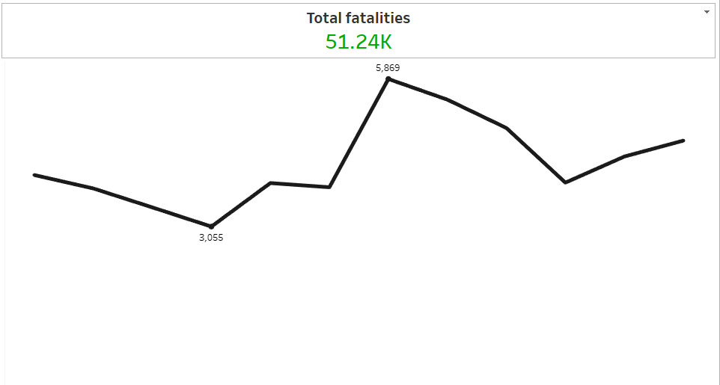
Visualization and Insight
Getting started with some KPIs
The total number of fatalities encountered by the crew members and passengers during the incidents is about 51.24k, having 5869 as the highest number of fatalities and 3055 as the lowest number of fatalities encountered.

Slide 9
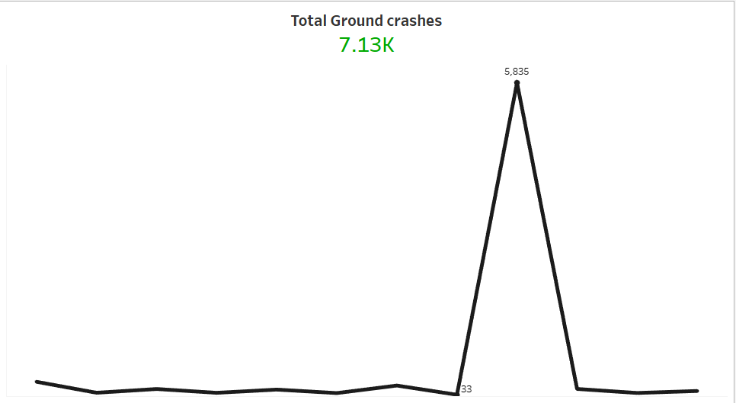
Visualization and Insight
Getting started with some KPIs
The total number of ground crashes is 7.13k, having 5835 as the highest number of ground crash which occurred mostly in September and 33 as the lowest number of ground crashes encountered.

Slide 10
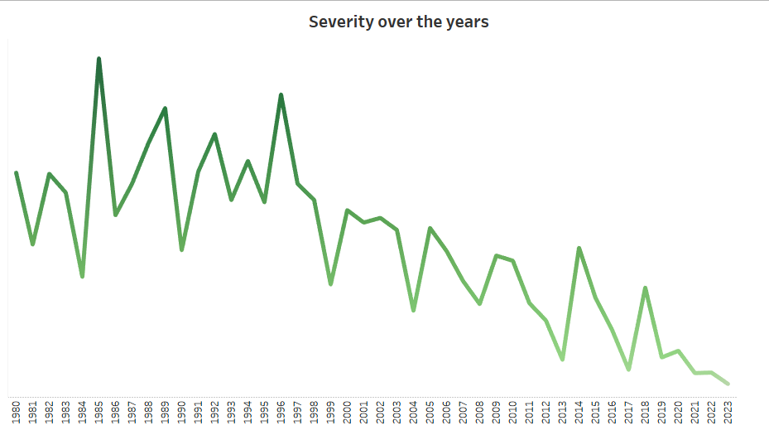
Visualization and Insight
Airplane Crashes over the years
Using a line graph I was able to visualize the airplane crash trend over the years.
From my graph it is evidently proven that there has been a significant reduction of severities over the years as year 2020,2021,2022 and 2023 had the lowest number of airplane crash fatalities compared to the previous years.

Slide 11
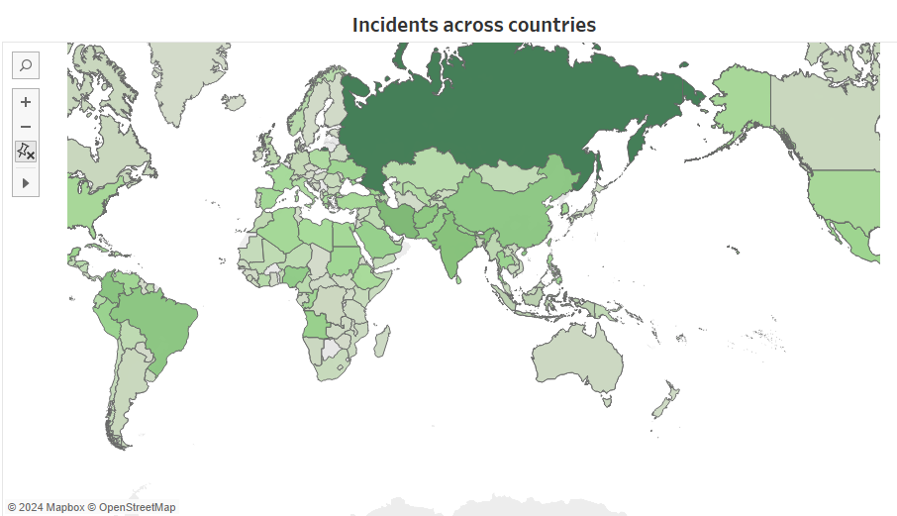
Visualization and Insight
Crash locations on a map
Using a map I was able to visualize the airplane crash occurrence and fatality rates over the years in different countries.
More crashes has occurred in Russia in the last 10.
Russia had used its military aircraft to much in a short period of time and that seemingly contributed to the crashes.

Slide 12
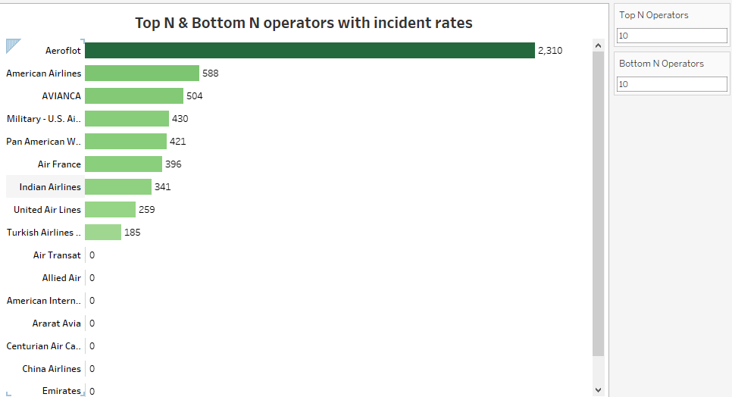
Visualization and Insight
Using a bar chart, some calculated fields and parameters I was able to plot a chart that shows the Top and Bottom N operators with higher and lower incident rates.
Aeroflot had the highest incident rate of about 2310 fatalities
I will advice that proper trainings should be conducted to avoid future casualties from poor performing operators as such.
Some operators such as Air Transat, Allied air and American international airways had 0 incident.
I will advice that more flights are given to such operators to control

Slide 13
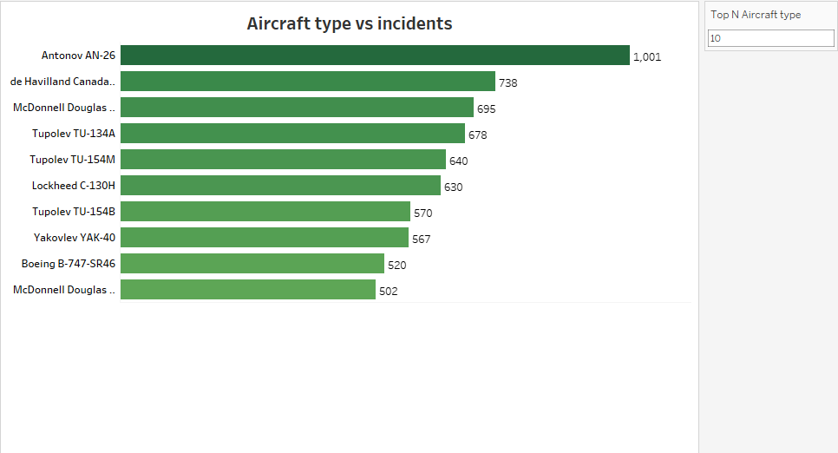
Visualization and Insight
Using a bar chart, some calculated fields and parameters I was able to plot a chart that shows the Top 10 aircraft type with higher incident rates.
Antonov AN-26 had the highest incident rate of about 1001 fatalities followed by de Havilland Canada DHC-6 Twin Otter 300
I will advice that proper maintenance of these 10 aircraft type before flying with them again avoid future casualties and also reduce the occurrence of aircraft related crashes.

Slide 14
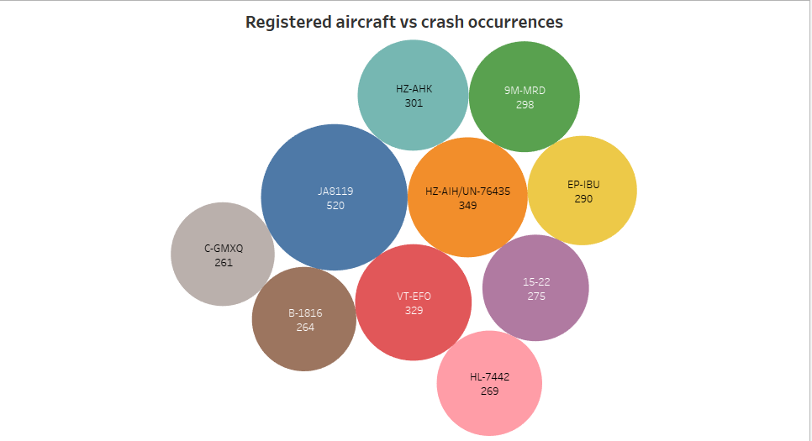
Visualization and Insight
Relationship between aircraft registration and crash occurrences
Using packed bubbles I compared the top 10 registered aircraft with the highest fatalities
There is no significant relationship between the registered aircrafts and their crash occurrence rate.
The registration of an aircraft has little or no effect on it being crashed.
Aircraft registration is not a contributing factor to Airplane crash occurrence.

Slide 15
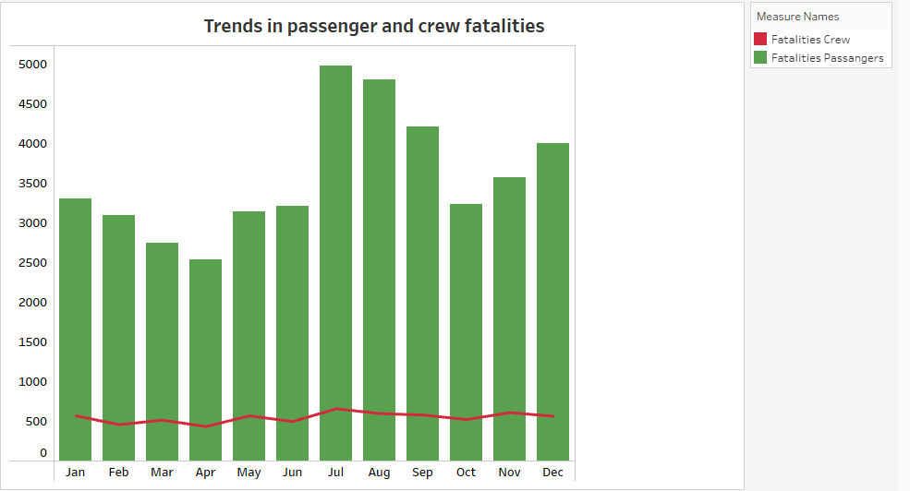
Visualization and Insight
Trends in passenger and crew fatalities
Using a Dual axis visualization, the bars represent the fatalities encountered by the passengers while the trend line represents the fatalities encountered by the crew members.
Passengers had more severity than the crew members
This can be as a result of the passengers not taking proper measures and safety regulation practices as the crew members did
It can also be attributed to an airplane having more number of Passengers than crew members

Slide 16
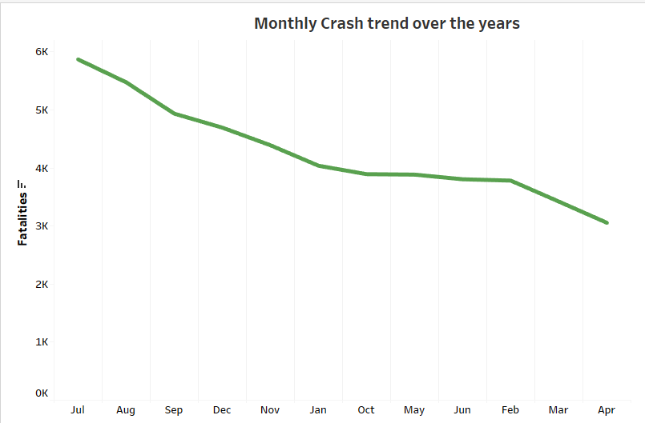
Visualization and Insight
Some factors contributing to fatalities
This is a line graph, showing a time trend of fatalities over the years.
The fatality rate is partitioned into months, with July, August and September topping the list.
These 3 months are said to be summer, summer comes with a high temperature which can cause an airplane to over heat and crash while trying to take off
This can be said to be a contributing factor to airplane crashes over the years
I will advice that such airplanes should stay grounded until the summer season is over and only be utilized in good weather conditions.

Slide 17
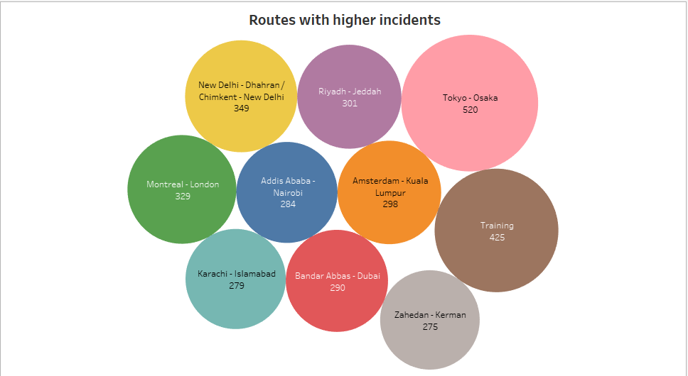
Visualization and Insight
Incident patterns on specific flight routes
I compared the top 10 routes with higher severity this is shown in the visualization.
The Tokyo to Osaka route ranked as number one with a total of 520 fatalities.
These 10 routes indicated are routes with a higher likelihood of incidents.
I will advice that such routes should be avoided and a better alternative should be replaced for aircrafts going towards such directions.

Slide 18
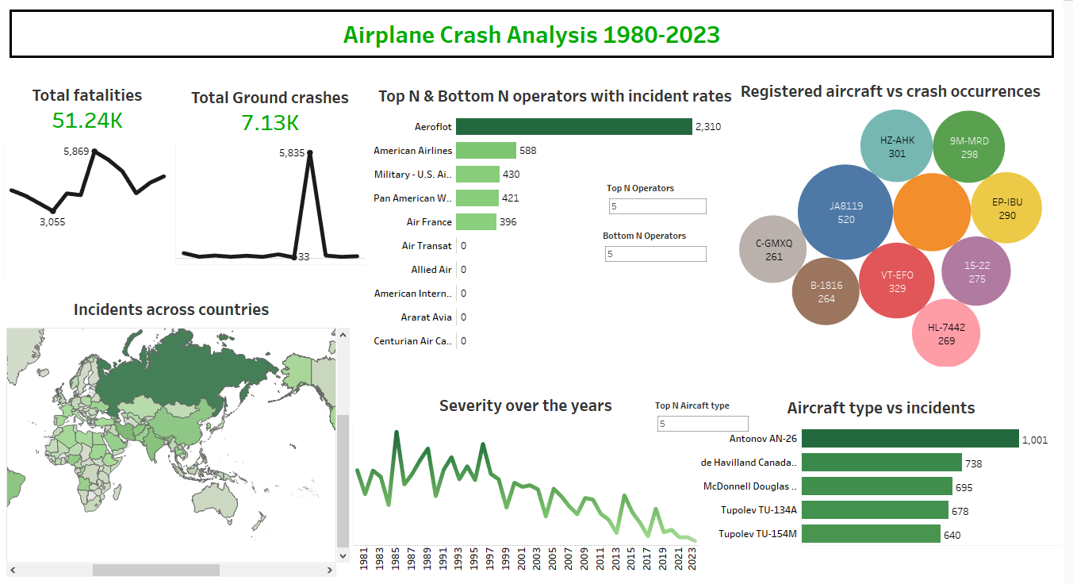
Dashboard 1

Slide 19
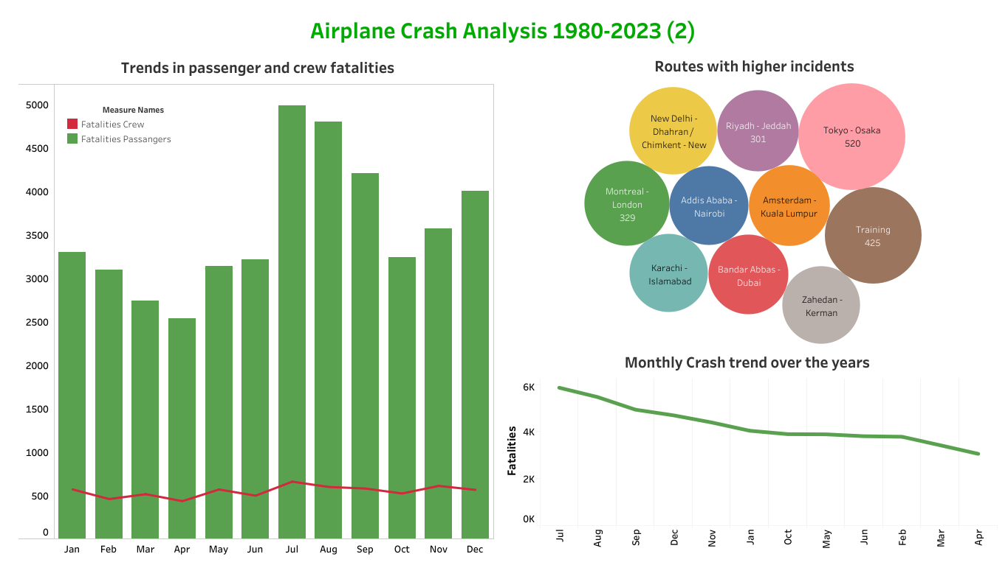
Dashboard 2

Slide 20
Conclusion
Statistics have it that 50% of aircraft crashes was as a result of pilot errors, however more crashes has occurred in Russia in the last 10 years this can be said to be as a result of frequent usage of the aircrafts for military purposes.
In the mid nineties were a period of increased aviation accidents, which prompted to the implementation of aviation safety regulation practices.
Some of the contributing factors are pilot error, bad weather conditions, equipment failure and inadequate maintenance.
Subsequently there has been a significant improvement in aviation technology such as development of more advanced flight control systems, improved weather forecasting and more reliable communication systems
With further innovations, advancements and implementations on aviation systems I can predict that there will be a drastic reduction of airplane crashes in the nearest future.

Slide 21
Thank You

